Slide 1
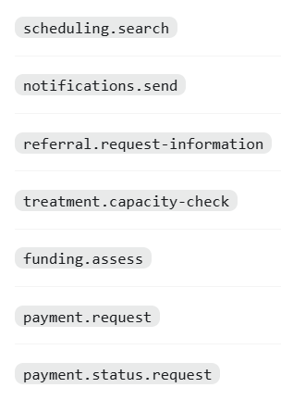
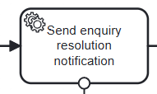
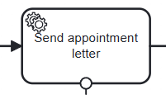
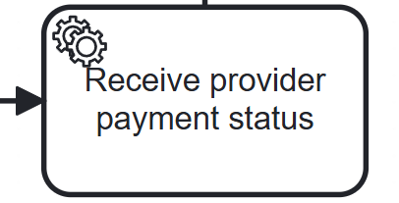
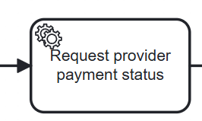
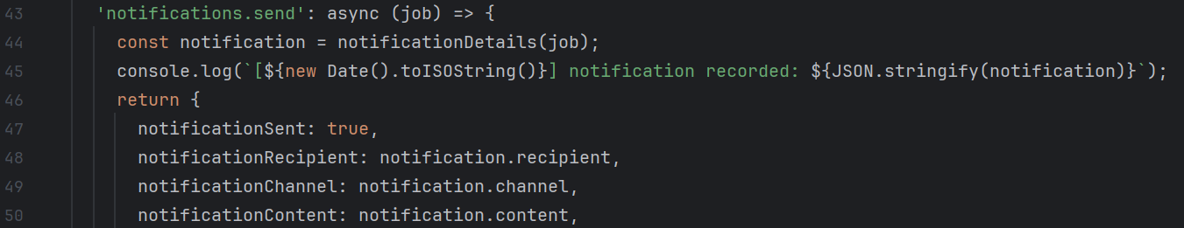

END-TO-END OPERATIONAL FLOW Logren Li 23084430
Operational Diagram
A single manual entry point in Tasklist creates the process instance; the workflow then combines human decisions, worker services and patient notifications.
Patient / Tasklist
Start process
Process instance created
Tasklist
Medical secretaries & call handling
Check information
Review referral
Find / confirm appointment
Notify patient
Decision
Appointment confirmed
Clinical, treatment & funding teams
Authorise request
Capacity &
funding
Pay
Treatment confirmed
Enquiry response & patient communication
Record enquiry
Send resolution notice
Route
use Java Message Handler
Allocate the consultation to administrative, appointment, financial, or clinical
Execution scope
22 User Tasks · 9 Service Tasks · 10 Gateways · 17 Camunda Forms · 7 worker job types · 2 patient-notification flows

Slide 2
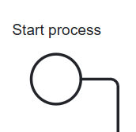

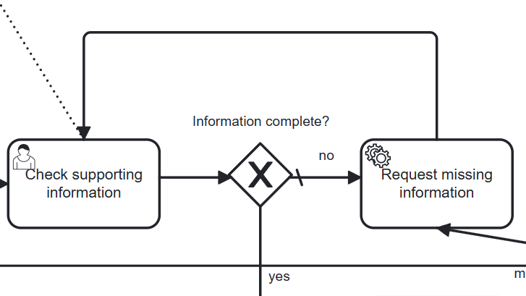


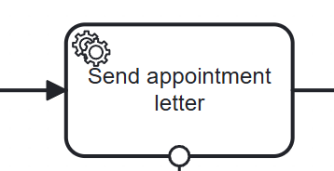
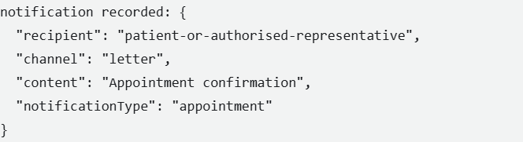

EVIDENCE FOR A DEPLOYABLE WORKFLOW Logren Li 23084430
Measurable Acceptance Criteria
Each criterion is phrased as an observable result that can be demonstrated in Camunda Tasklist and the worker log.
01
Manual process start
Clicking Start process in Tasklist creates one process instance and presents Check supporting information as the first User Task.
02
Mandatory gateway decisions
Required form selections produce the matching yes/no or named gateway route; incomplete information follows the request-information route.
03
Resolved alternative routes
No-capacity(referral-capacity-resolution) and payment-exception routes(treatment-payment-investigation) require a human resolution: retry, manual/urgent handling, or a closed end state—without an uncontrolled loop.
04
Worker coverage
Every configured service-task type has a matching worker handler. Where an automated decision is required, the handler returns the variable used by the downstream gateway; other handlers record their execution outcome.
05
Notification evidence
Appointment and enquiry-resolution notifications record notificationSent, recipient, channel, content and send result in the worker output.
Demonstration evidence: Tasklist screenshots, completed form values, worker console logs and process-instance history.

Slide 3
Patient enquiry operational diagram
Standalone Camunda 8 process
External enquiry source
Message start
Identify patient
Java worker
Record and classify
Call handling
Tasklist manual start
Start form
Response route
Administrative
Appointment
Finance
Clinical triage
Routine or urgent
No: return to classification
Resolved?
Yes: audit record and close
Hospital_Enquiry_Standalone | BPMN v5
Notes:
Source: F:\BPM-EA-and-AISD\patient-enquiries-package\16-core-patient-enquiries-standalone.bpmn. The diagram is a simplified, editable operational view. The external black-box participant sends the Patient enquiry received (standalone) message to Q_Start. Tasklist manual start uses Q_Manual. Q_Init and Q_Notify are Java job worker tasks. The four category routes are administrative, appointment, financial, and clinical. Clinical triage separates urgent and routine responses. An unresolved answer returns to Q_Record; a resolved answer reaches audit and the end event.

Slide 4
Measurable acceptance criteria
Standalone patient enquiry process
Measure | Acceptance threshold | Observed evidence
Entry | Manual form available; message start creates a Q_Record task | Start form bound; message reached Q_Record
Routing | Four enquiry types and both clinical urgency paths reach the intended tasks | 5/5 paths completed
Rework | Unresolved returns to Q_Record; resolved reaches audit and closure | Loop observed; audit true in 5/5 cases
Reliability | Five test paths complete with zero incidents | 5/5 completed; 0 incidents
Evidence: Camunda v5, verification-last.json (28 Sep 2026)
Notes:
Evidence: F:\BPM-EA-and-AISD\patient-enquiries-package\verification-last.json and F:\BPM-EA-and-AISD\patient-enquiries-package\deployment-last.json. The five completed scenarios cover administrative, financial, routine clinical, urgent clinical with a rework loop, and message-started appointment enquiries. All five ended COMPLETED. The integration runner checks for incidents on each path; querying Camunda variables confirmed auditRecorded=true for all five. hasStartForm=true comes from the deployed process definition. The standalone Tasklist manual form was not tested end to end in a browser; direct process start and message start were tested through the API.

Slide 5
Treatment Booking and Funding
Operational diagram | Clinical, Booking and Finance responsibilities with external message boundaries
Clinical
Record consent and
authorise request
Authorise urgent
treatment override
No
Consent and treatment authorisation
Start
Authorised?
Stop
Booking
Yes
×
Pending booking
+ owner notified
Check treatment
capacity
No
Capacity, retry and appointment confirmation
PT30M retry
Confirm treatment
appointments
Error -> pending
Capacity?
End
Finance
Advance payment?
Funding, payment outcome and investigation
Assess funding +
Finance decision
Secure payment
request
PSP result +
status correlation
No advance payment or Paid -> Booking confirms
Missing -> investigate + status query
Declined/cancelled -> Finance approval + confirmed cap | Urgent -> Clinical override
Patient
Treatment & Lab Services
Payment Provider (PSP)
Consent / appointment notice
Capacity response
Payment and status callback
External participants show system boundaries. The JavaScript Worker simulates service responses and PSP messages.
Model control: a missing confirmation enters investigation. A declined/cancelled retry requires explicit Finance approval.
Notes:
The model separates Clinical, Booking and Finance responsibilities. Clinical staff record consent and authorise the request. Booking checks capacity; unavailable capacity creates a pending task and a 30-minute retry. Finance assesses funding. If advance payment is needed, the Worker sends a demonstration payment request and publishes a payment-status message correlated by process instance. Missing confirmation is investigated, and declined or cancelled payment can be retried only after explicit Finance approval. The Patient, Treatment and Lab Services, and PSP are separate external participants. The Worker is a local JavaScript demo, not a real hospital or PSP integration.

Slide 6
Measurable Acceptance Criteria
TARGETS, NOT TEST RESULTS
Pass/fail targets for the operational BPMN and Worker
ID
ACCEPTANCE TARGET
MEASURABLE PASS CONDITION
AUDIT STATUS
AC-1
Deployment and forms
One deployment creates Process_Treatment and exactly 7 expected forms.
DEPLOYED
C8 8.10 alpha5 / v3
AC-2
Authorization and capacity
Unauthorised path activates 0 downstream jobs. Capacity=false or EXTERNAL_UNAVAILABLE creates pending task + PT30M timer.
PARTLY STATIC
Live paths not run
AC-3
Message correlation
Exact message name and process-instance correlation key advance only the matching waiting instance.
STATIC MATCH
Live message test open
AC-4
Payment safety
Missing status never auto-recharges. Each declined/cancelled retry needs Finance approval and must stay within the confirmed attempt cap.
NOT RUN
PSP rules and retry cap to confirm
AC-5
Worker execution
All 4 BPMN job types are handled. Capacity BPMN error is caught; each successful job completes with expected variables.
SYNTAX CHECK PASS
E2E tests open
Confirm before final sign-off
30-minute retry policy • PSP decline/cancel meaning and idempotency • Finance retry authority and attempt cap • Whether a Java Message Handler is graded as mandatory
Open rules are marked for Tutor / Stakeholder confirmation in the Acceptance Test Plan.
Notes:
These are measurable acceptance targets, not claims that every test has passed. We verified XML structure, Worker syntax, and deployment of the process with all seven forms on the local Camunda 8.10 alpha runtime. Branch behavior, browser form submission and live message correlation still need evidence. Final pass criteria count downstream jobs, require a PT30M timer, match the message name and process-instance key, and prevent any payment retry without Finance approval. The retry rule, PSP semantics, and Java handler expectation need confirmation.

Slide 7
Chemotherapy cycle workflow
My contribution: executable Camunda 8 BPMN, nine forms and a Node.js mock worker
01
02
03
04
05
Request
Results
Clinical review
Decision
Follow-through
Classify cycle review or formal treatment change.
Wait for required lab and imaging results.
Clinician reviews findings and patient condition.
Continue, delay or change treatment.
Schedule, review funding if needed, then notify the patient.
EXCEPTION CONTROLS
MISSING RESULTS
Keep the case pending and retry. Clinical review waits for all required results.
NO FORMAL REQUEST
Reject the treatment change and leave the schedule unchanged.
URGENT DELAY
Maintain the safety hold until follow-up authorisation is complete.
Clinical decisions remain with human tasks.
Notes:
Good morning. I worked on the chemotherapy cycle review and treatment-modification part of our project. My contribution has three parts: an executable Camunda 8 BPMN process, nine forms for user tasks, and a Node.js worker that simulates the external service steps.
The main route starts by classifying the request and checking whether the required results are available. Once the results are complete, a clinician reviews the patient and chooses whether to continue, delay, or change treatment. The authorised route then handles scheduling, finance review when a funding impact exists, and patient notification.
I focused on making exception handling visible in the process. Missing results stay pending and go through a controlled retry, so the process cannot reach clinical review too early. A treatment change without a formal request is rejected and does not update the schedule. For urgent delay, the safety hold remains until follow-up authorisation is complete. Clinical decisions stay with human tasks. The worker only supplies deterministic demo responses; it does not connect to hospital systems or real patient data.

Slide 8
Local validation evidence
Model checks and two local Tasklist end-to-end scenarios
48
0
Camunda Modeler errors or warnings
2
MODEL CHECKS PASSED
Tasklist end-to-end scenarios completed
0 failed
COMPLETED
NEXT TEST
Standard cycle review
Urgent-delay walkthrough
Mock results returned, schedule updated and patient notice sent.
Model checks cover the safety hold and follow-up authorisation. The Tasklist end-to-end walkthrough is still pending.
Treatment change without a formal request
Rejected, with no schedule update.
Demo worker only. No real patient data or hospital-system integration.
Notes:
For validation, I ran the model-level test suite. It reported 48 checks passed and zero failures, covering the main route as well as missing-results retry, treatment-change rejection and urgent-hold authorization branches. Camunda Modeler also showed zero errors and zero warnings for the BPMN.
I then completed two local end-to-end scenarios in Tasklist. In the standard cycle review, the worker returned that the results were available, then confirmed a schedule update and a patient notification. The demo references were LAB-DEMO-001 for the results, CYCLE-DEMO-001 for the schedule and NOTICE-DEMO-001 for the notice. In the treatment-change scenario, the formal request was absent, so the process rejected the change and did not update the schedule.
The urgent-delay branches passed model-level checks, but I have not yet completed that Tasklist walkthrough end to end. That is my next validation step. The current worker returns deterministic mock responses only. It uses no real patient data and does not integrate with hospital services, so these results demonstrate workflow behavior rather than clinical operation. Thank you.

Slide 9
Clinic Letter workflow
My contribution: BPMN model, four forms and a Java demo worker
START
CONSULTANT
CONSULTANT
SECRETARY
JAVA WORKER
Consultation
completed
Draft clinic
letter
Clinically
approve
Recipients +
admin checks
Simulated
dispatch
Dispatch requires clinical approval AND both administrative checks.
Clinical decisions stay with the Consultant.
Successful dispatch cancels remaining monitoring.
01
Notes:
Speaker script (allow 45-55 seconds, including pauses):
My part is the Clinic Letter process. I built an executable BPMN model, four forms and a Java demo worker. After consultation, the Consultant drafts and clinically approves the letter. The Secretary then checks the recipients and administrative details. Dispatch requires approval and both checks. The worker simulates sending and records the dates. Successful dispatch cancels the remaining monitoring. Clinical decisions always stay with the Consultant.
Reference only — do not read aloud:
Source: clinic-letter-sprint02-demo.bpmn; forms/; java/src/main/java/local/clinic/ClinicLetterWorker.java and LetterLogic.java.

Slide 10
Rework and delay monitoring
Rework protects approval; timers monitor delays
EXCEPTION CONTROLS
PARALLEL TIMER ROUTES
Clinical rejection or concern
Milestone | Business timing | Demo
Weekly reminder | 7 days; repeat weekly | 10 s; repeat
Admin Manager | 1 calendar month | 20 s
Higher Management | 3 calendar months | 30 s
Return to the Consultant.
Incomplete admin checks
Return to the Secretary.
Dispatch rejected
Human resolution; authorised retry only.
Timers run in the Camunda engine.
Business timing is shortened for the demo.
02
Notes:
Speaker script (allow 45-55 seconds, including pauses):
The model also handles exceptions. Clinical rejection returns the letter to the Consultant, while incomplete administrative checks return it to the Secretary. A dispatch rejection needs human resolution and authorisation before retry. In parallel, the model has weekly reminders and management notifications after one and three calendar months. For the demonstration, I shortened these waits to ten, twenty and thirty seconds. Camunda runs the timers, and successful dispatch cancels pending monitoring.
Reference only — do not read aloud:
Sources: clinic-letter-sprint02-demo.bpmn and formal-model.bpmn. Repeated demo reminder waits 10 seconds after the preceding reminder job completes. Approval suppresses the reminder action, while the timer loop remains until dispatch completes.

Slide 11
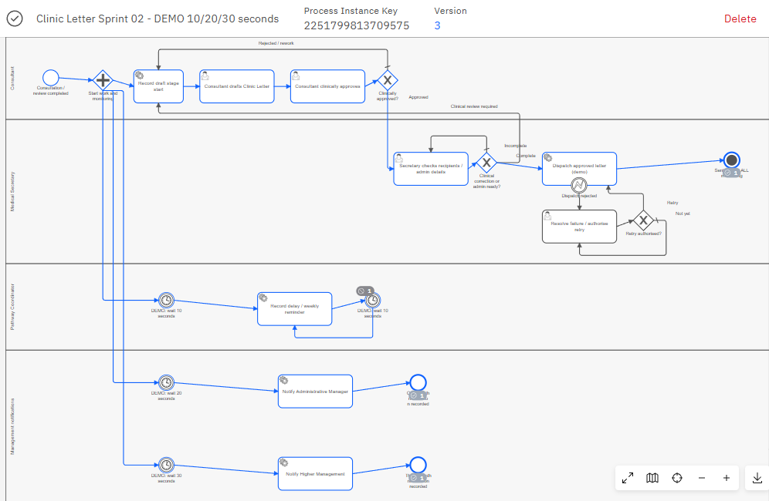

What I verified
Local Camunda demonstration | 28 September 2026
6
OPERATE: COMPLETED INSTANCE
Java test groups passed
8
Isolated engine scenarios passed
1
Manual Tasklist walkthrough
completed: DEMO-CL-002
Coverage: normal flow, rework, retries and timers.
Synthetic data and simulated dispatch only.
03
Notes:
Speaker script (allow 45-55 seconds, including pauses):
I verified the implementation with six Java test groups and eight isolated scenarios on the local Camunda engine. They covered normal flow, rework, retries and delay monitoring. I also completed a manual Tasklist walkthrough for DEMO-CL-002. Here, Operate shows the completed instance and the status SIMULATED_SENT. This is evidence that the local demo works. Sending is simulated, so real hospital integration remains future work.
Reference only — do not read aloud:
Evidence: java/evidence/verification-summary.json and java-engine-verification.json (2026-09-28). Automated scenarios use isolated process IDs and job types. Manual instance 2251799813709575, definition version 3, completed 2026-09-28 16:01:31 Asia/Shanghai. Screenshot supplied by user: codex-clipboard-b697ae1f-c868-43ee-be05-88ff25ad05e5.png. Dispatch details screenshot identifies worker clinic-letter-java-simulated. The eight isolated scenarios are NORMAL_FORMAL, NORMAL_DEMO, CLINICAL_REWORK, SECRETARY_CLINICAL_CONCERN, ADMIN_REWORK, BUSINESS_RETRY, TECHNICAL_RETRY, DELAY. These are local demo tests, not production acceptance.
Design reference: Treatment_Booking_Funding_Operational_Acceptance_3min.pptx (light background, navy/teal, workflow and acceptance structure); Jin Wang.pptx (contribution and evidence structure).

